Slide 1
Shell Bootcamp 2024 3 Reflections for Week #3
PREETI PALLAVI
Date : 06-Sept-2024

Slide 2

About Me
Know your own worth and capabilities. Believe in oneself. Follow the saying “My network is my net worth”.

Slide 3

My learnings from this week!

Slide 4
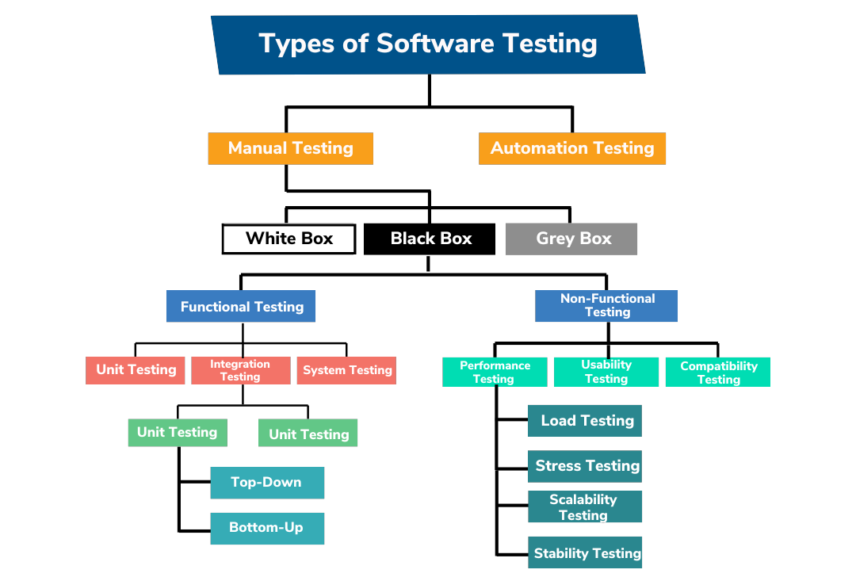
Learning 1 | My takeaways
There are many different types of testing and hierarchy of testing
Mostly functional (testing major features) & non-functional (testing the load, storage, UI, etc) are 2 broad categories of testing
Hiercarchy of testing: Unit testing (by devs) -> System testing -> Integration testing (by QAE) -> User Acceptance testing (by Business users)
Types of testing: Black box (by QA engineers), white box (by devs), grey box testing (by automation engineers), green box testing (by Business users)
Testing is one of the most important phases of SDLC since the entire project relies on this phase to move to production environment.

Slide 5
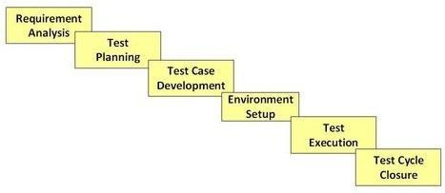
Learning 2 | My takeaways
STLC is an important cycle that focuses on simplifying the entire testing phase of SDLC
Requirement analysis (to define the scope of testing – since its not feasible to test everything in a project or automate every manual process)
Test planning (to define what to test, how to test, when to test, where to test, why to test, who will test, etc , and go on to build the test plan document which saves money of company & manages time spent on the project)
Test case development (creation, verification and rework of test cases and test scripts – use GHERKIN laguage )
Environment setup (team should prepare the smoke test cases to check the readiness of the test-environment setup)
Test case execution (execute all the TC)
Test cycle closure (Testing team will meet , discuss and analyze testing artifacts to identify strategies that have to be implemented in future)

Slide 6
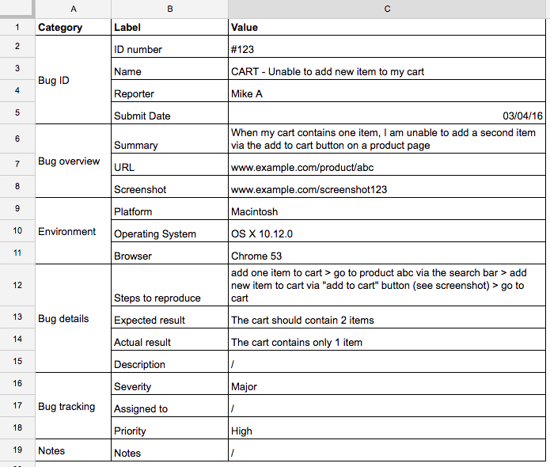
Learning 3 | My takeaways
Creating a detailed Bug report:
Check if the bug is reproducible in nature or not – perform same operation 3-4 times – if it is still a problem – yes its confirmed it’s a bug
Check and validate the requirement
Test the data what we’re using is actually registered in the system as per the standards
Bug report must contain:
Description of bug: what is the bug
Steps to reproduce the said bug
Timestamp
Severity
Priority
Asignee
Screenshot or recording

Slide 7

Relevance of learnings for my organization

Slide 8
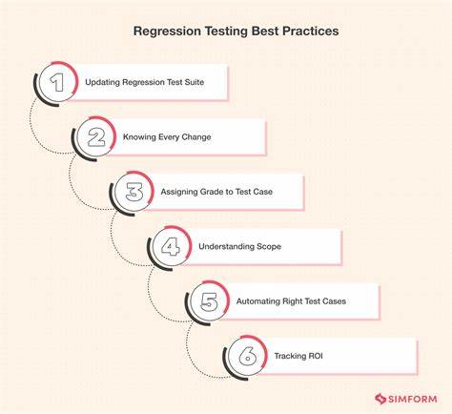
Learning 1 | Relevance for Shell
Test Suite – where you keep all test cases (integration TC + auto TC)
Smoke testing: Select some of the test cases from the bulk that covers key or basic functionalities – max 15
Regression – when you’re going to test all possible scenarios end-to-end - Conditions to perform this regression testing:
When a new enhancement/modification/addition of new feature
Whenever a defect has been fixed – make sure fixing this bug didn’t break other features
Whenever a CR has been deployed – check all other features
Performance – non functional testing - load testing –stress testing, Spike testing
Ad Hoc – exploratory – informal form of testing – when official testing has been done – everything is done

Slide 9
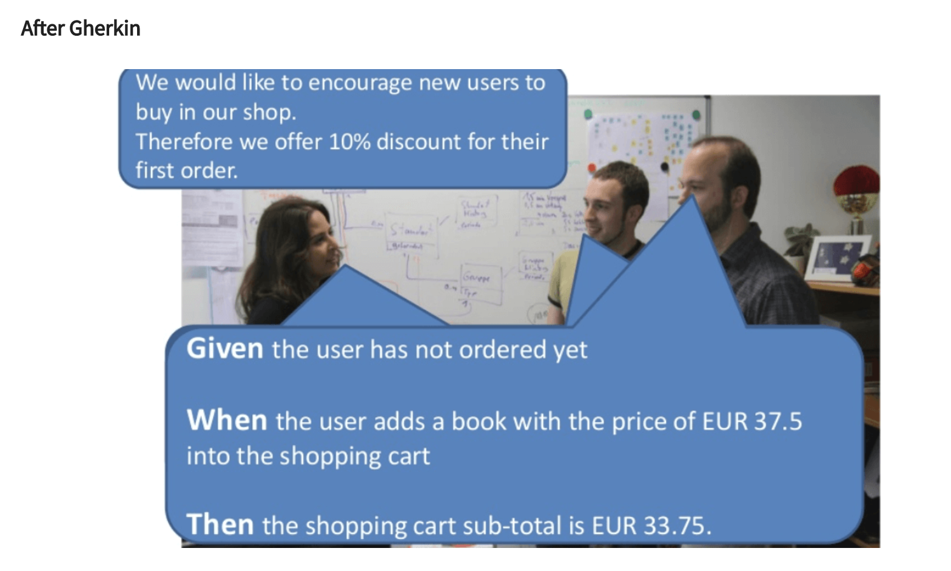
Learning 2 | Relevance for Shell
Gherkin language makes it easier for everyone to read and understand the test cases especially the QA engineers since they may not have much idea about the entire internal architecture of the project.

Slide 10
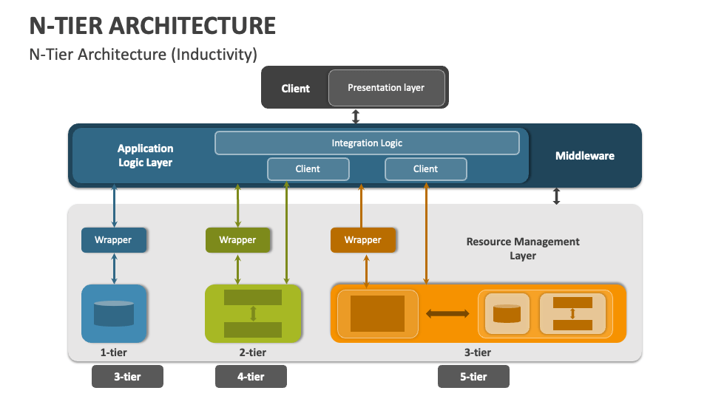
Learning 3 | Relevance for Shell
1-tier architecture: when presentation, appln & data layer – all 3 layers available at one place , Example: calculator, notepad (appl logic, database all in 1 place)
2-tier architecture: when the appl & pres layer available at 1 place, data layer available at another place, Example: mcd, dominos, kfc in multiple locations
3-tier arch: when all 3 layers are separated , example: any website, why? - cuz of dynamic nature of appl
Extension: n-tier arch , ex: Instagram – multiple clients, multiple pres layers

Slide 11

Challenges in implementing learning

Slide 12
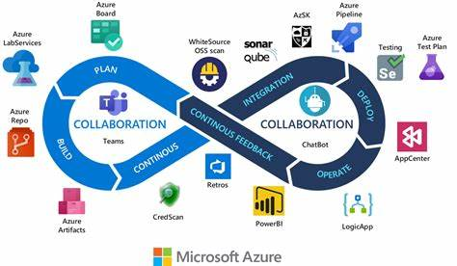
Challenge faced while implementing Learning 1
Understanding what is Azure DevOps, Azure VM, what is build management tool and how to use it, how to create .yml file and pom.xml file and check the build status.
Initially got errors but then took time to mention the configurations carefully and then, it worked successfully.

Slide 13
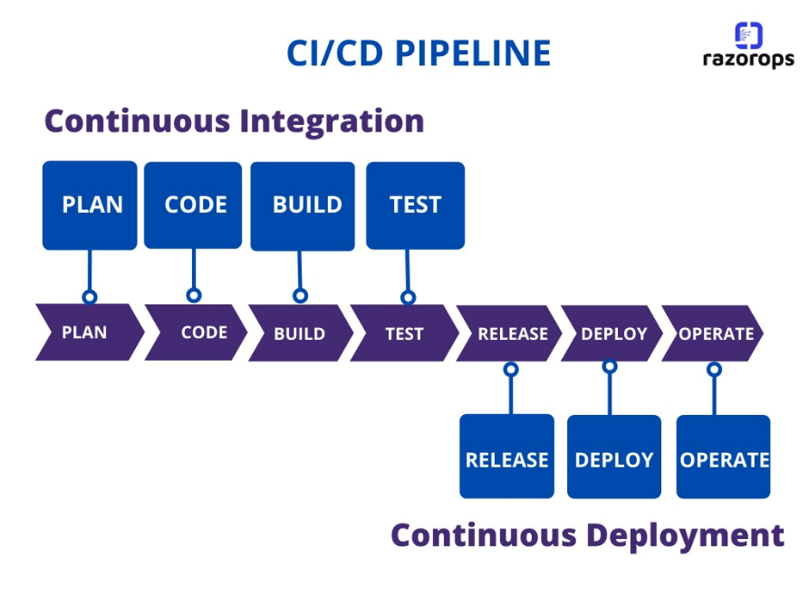
Challenge faced while implementing Learning 2
CI And CD is the practice of automating the integration of code changes from multiple developers into a single codebase. It is a software development practice where the developers commit their work frequently to the central code repository (Github or Stash). Then there are automated tools that build the newly committed code and do a code review, etc as required upon integration.
Need to remember these concepts

Slide 14
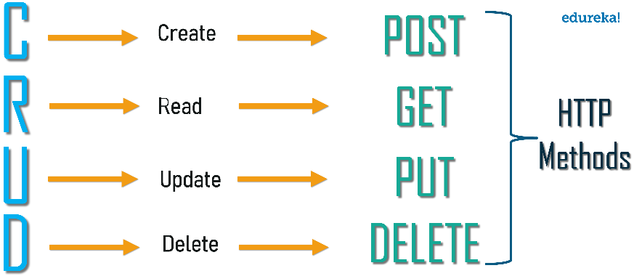
Challenge faced while implementing Learning 3
New concepts in API
2 types of API:
Rest (representational state transfer): faster data transfer rate, less secure than soap
Soap (simple object access protocol): slower data transfer rate, more secure than rest (banking)
Stateful application: the state of a server memory in a browser (cache/cookies) is set to true, Data is saved in browser, hackers hack server memory, not database , so database is few, servers are in millions
Stateless application: the state of a server memory in a browser (cache/cookies) is set to false, works on session id which changes everytime, and sessions expire in 2mins

Slide 15

Action Plan

Slide 16
My Action Plan for this Week
Actions
Timeline
Status
Practice the learnings, create projects and implement CI/CD pipelines, check out Fitnesse tool
Mon to Fri – learn about BA, Agile, SDLC, Azure devops, RDBMS
Sat – Brush up all the learning and start a new project
Sun – Implement the new learnings and learn new features of Azure
Learning in progress

Slide 17

Learning is also Fun!

Slide 18
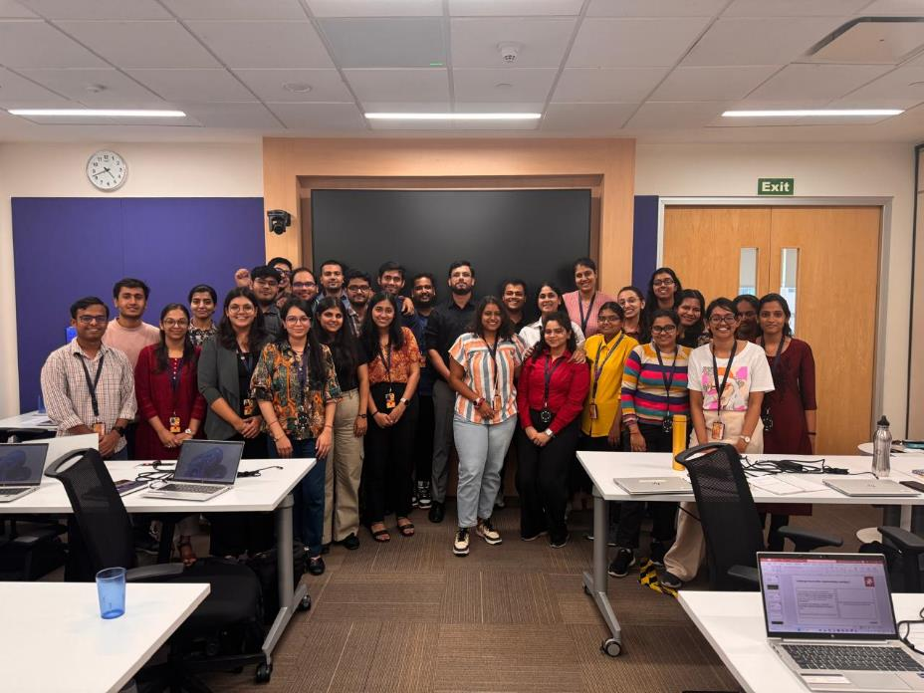
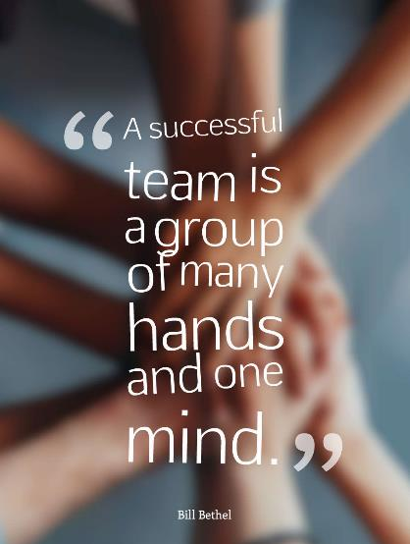
Learning is also Fun!
All the group activity was interesting, creative and team bonding grew through the course of the week, it was fun to collaborate and work on the tasks assigned to us, make mistakes and learn & grow together.

Slide 19

Summary
Learned about User stories, scenarios, tasks, subtasks
Learned how to write Test Cases in Gherkin language, Bug reports
Learned about Azure DevOps, how to create and use VMs

Slide 20
Thank You

